Slide 1
JavaScript & Java Sips
The title says it all… no subtitle needed

Slide 2
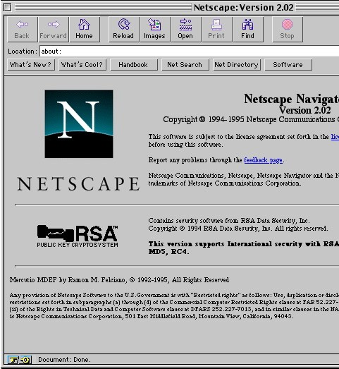
History
Originally to be Scheme-based, but Java was super trendy in ’95
“Standardized” in ’96 as ECMAScript
Variants include JScript (Microsoft) and ActionScript (Adobe Flash)
Humble beginnings…
Notes:
Point to the location bar and make reference to window.location
Discuss history of JS, Netscape, the browser, etc. Mention node.js

Slide 3
Assumptions
You already know how to program
You already know how HTML/CSS works

Slide 4
Resources
MDN (https://developer.mozilla.org)
Difficult to navigate (use Google)
Still the best reference for HTML/CSS/JS/DOM
Examples from this tutorial
https://github.com/cpicon92/javasips

Slide 5
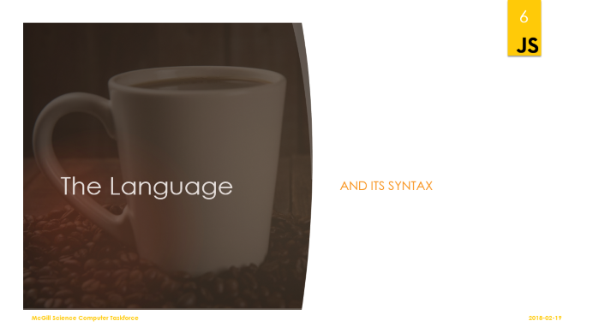


Three 40-minute lessons

Slide 6
The Language
and its syntax

Slide 7
Basic Syntax
var x = 7;
var y = 14;
x + y;
> 21
x + y < 25;
> true
while (x + y < 25) {
x++;
}
x;
> 11
Originally based on Java (C-like)
Variables are not typed, follow similar naming conventions (i.e. camelCase)
Control flow statements, operator precedence, associativity are identical
Extra comparison operators: === and !==
Notes:
Instruct students to open the developer console in their browser of choice to try some of this
Mention to avoid ==

Slide 8
Types
Boolean
Null
Undefined
(not the same as “not defined” -> reference error)
Number
String (no char)
Object (Array)
var x = "1";
var y = 7;
x + y;
> "17"
y + x;
> "71"
y - x;
> 6 //why?
x - 0 + y
> 8
var a = 5;
var b = "hello";
a - b;
> NaN //not its own type; a Number
!undefined; //coercion
> true;
Notes:
Number == IEEE 754 double-precision (64-bit) binary floating-point (i.e. a double in java)
String literals can use either double or single quotes
Strings are objects, like in Java, and have similar methods
String.length is a prop not a method

Slide 9
Objects and Arrays
var o = {}; //an empty object literal
o.hello = "world";
o;
> {hello: "world"}
var another = {something: "else"};
another.something;
> "else"
delete another.something;
another["something"]; //alternative syntax
> "else"
A set of key-value pairs
Similar to dictionaries in Python, Map<String, Object> in Java
Use prototypical inheritance instead of classes (no classes in JS)
Arrays are a special type of object (unlike in Java)
Notes:
Arrays are actually lists

Slide 10
Arrays Example
var things = []; //an empty array literal
things[0] = o;
things [1] = another;
things;
> [{hello: "world"}, {something: "else"}]
//arrays are objects with methods
[6, 8, 9, 3, 5, 7, 8].slice(1, 5);
> [8, 9, 3, 5]
//to delete from an array use splice
var arr = [6, 8, 9, 3, 5, 7, 8];
arr.splice(2, 1);
arr;
> [6, 8, 3, 5, 7, 8]
The delete operator works on arrays, but it probably isn’t what you want
Notes:
o and another are the objects from the previous example

Slide 11
Iteration
var arr = [6, 8, 9, 3, 5, 7, 8];
for (var i = 0; i < arr.length; i++) {
arr[i] = arr[i] * 2;
}
arr;
> [12, 16, 18, 6, 10, 14, 16]
var obj = {name: "Seiji Amasawa", age: 12, gender: "n/a"};
var out = "";
for (var k in obj) {
out += k + " is " + obj[k] + ", ";
}
out;
> "name is Seiji Amasawa, age is 12, gender is n/a, "
For loops work the same as in C++/C99 and Java
For-in loops iterate over the properties of an object
But not (just) the elements of an array!! (don’t use for arrays)

Slide 12
Functions
var x = 5;
var incX = function() { //a function literal
x += 5;
};
//can be invoked before it is declared
function incX() {
x += 5;
};
incX();
x;
> 10
incX();
x;
> 15
Also objects
May be used as methods by attaching them as object properties
Notes:
302-style functional programming is supported, but not enforced

Slide 13
“Methods”
//methods
var obj = {
addFive: function(x) {
this.lastFive = x; //inside a method, "this" refers to the enclosing object
return x + 5;
},
addTen: function(x) {
return x + 10;
}
}
obj.addFive(1);
> 6
obj.lastFive;
> 1
Notes:
methods are simply functions attached to an object
they are run with the enclosing object as execution context

Slide 14
New keyword & prototypical inheritance
Function-based instead of class-based
“new” creates a new instance of an object using the passed function as a constructor
The “prototype” for the new object is the constructor function (also an object) itself
No traditional OO access control (i.e. no “private” keyword)

Slide 15
Prototypical inheritance - 2
//constructor and "class definition" all in one (note the capital variable name)
var Cat = function(name, age, coatColour) {
this.name = name; //"this" in a constructor function refers to the new instance
this.age = age;
this.coatColour = coatColour;
//a method
this.sayMeow = function() {
return "meow " + this.name;
};
};
var cat1 = new Cat("Bob", 42, "brown");
cat1;
> Cat {name: "Bob", age: 42, coatColour: "brown", sayMeow: ƒ}
cat1.sayMeow();
> "meow Bob";
Cat("Bob", 42, "brown"); //missing "new"; "this" becomes the global execution context a.k.a. "window"
> undefined //function does not actually return anything
Notes:
methods are simply functions attached to an object
they are run with the enclosing object as execution context

Slide 16
Prototypical inheritance - 3
//modify the prototype directly; a cleaner way of adding methods
Cat.prototype.hiss = function() {
return "hsssss " + this.name;
};
var cat2 = new Cat("Hermione", 12, "golden");
cat2;
> Cat {name: "Hermione", age: 12, coatColour: "golden", sayMeow: ƒ} //note that "hiss" is not listed
cat2.hiss();
> "hsssss Hermione" //still works
var o = {};
o.__proto__.constructor.name;
> "Object"
cat2.__proto__.constructor.name
> "Cat"
Notes:
methods are simply functions attached to an object
they are run with the enclosing object as execution context

Slide 17
JSON
Most of JavaScript’s literals
No functions, no variables
Stores data structures, but cannot be executed as code
Parseable by virtually all programming languages
A few extra rules:
Strings only use double quotes
Object property names must be strings
Examples of JSON vs. XML: https://json.org/example.html
Notes:
A String subset of JS object/array literal used to store data in String

Slide 18
The Environment
the browser and the DOM
Notes:
Don’t forget to mention strict mode / automatic variable declaration on window object

Slide 19
The window
“window” is the global scope object
Variables declared outside a function are attached to “window”
Avoid declaring global variables and functions
Most JS libraries attach at most one object/function “entry point”
Contains references to browser state variables (e.g. window.location, window.console)
Contains the DOM (window.document)
var x = 5;
window.x = 7;
x;
> 7
Notes:
Mention the way variables created without “var” are always attached to the window (potential source of bugs)

Slide 20
The window object - Example
var y = 3;
var f = function() {
y = 5;
z = 10; //never use a variable without declaring it first
var a = 9;
};
f();
y;
> 5
z;
> 10
a;
> undefined
window.alert("I suck"); //never use window.alert
alert("I suck even more"); //same
Notes:
methods are simply functions attached to an object
they are run with the enclosing object as execution context

Slide 21
The DOM
Represents an HTML document as a tree data structure
Consists of Node objects with a list of “childNodes”
A Node could be an element (tag)… or not
Text is a node, so are comments
Changes to the DOM are reflected as changes to the page
Begins with window.document Node, followed by .head and .body
Notes:
Note that the DOM exists outside of the browser and HTML many XML parsers use it
Don’t confuse the DOM Node object with Node.js (the similarity is a coincidence)

Slide 22
Navigating the DOM
Elements vs. Nodes
Element
Node that represents an HTML tag
Can have children
Has special pointers for navigating only the Element tree (skips Text and Comment nodes): firstElementChild, lastElementChild, nextElementSibling, children, etc.
Has (mutable) innerHTML property containing all child nodes as valid HTML string
All Elements implement querySelector() and querySelectorAll(), starting at that point in the tree
Node
All items in the DOM tree implement this interface
Implements standard tree navigation pointers: firstChild, lastChild, childNodes, parentNode, nextSibling, previousSibling, etc.
Has a nodeType: ELEMENT, TEXT, COMMENT (see https://developer.mozilla.org/en-US/docs/Web/API/Node for a full list)
Not all node types can have children
All nodes have a textContent property containing any content text and the content of children

Slide 23
Modifying the DOM
New Nodes are created with document.createElement(), document.createTextNode(), document.createComment(), etc.
Element attributes are modified with .setAttribute()
Children are added with appendChild(), insertBefore()
or by setting .innerHTML or .textContent directly (deletes existing children)

Slide 24
Event Listeners
Programmer-defined callback functions which are executed when a specific event happens (e.g. an image has loaded, a button has been clicked, etc.)
Virtually all browser-based JS starts with an event listener
The event listener function is passed an “Event” object with extra info about the event (e.g. what was the x/y position of the mouse when it happened)
Notes:
Mention setTimeout, setInterval, and requestAnimationFrame

Slide 25
XMLHttpRequest
AJAX
Asynchronous JavaScript and XML
XML is almost never used for this anymore
XMLHttpRequest makes arbitrary HTTP requests
“load” event fires when data is loaded
Has other events like “progress”
Returned data may be used as is (text, HTML, image files) or parsed (JSON, XML, YAML)
//req object tracks the request through its whole lifecycle
var req = new XMLHttpRequest();
req.addEventListener("load", function() {
console.log(this.status); //404/200/etc
//if the data is just a string:
console.log(this.responseText);
//if this was json then:
var data = JSON.parse(this.responseText);
data.something;
});
req.open("GET", "http://www.example.org/example.txt");
req.send();

Slide 26
Frameworks, Libraries, & Practices
the real world Comes Crashing IN
Notes:
Explain the difference between a library and a framework

Slide 27
JQuery
jQuery is a fast, small, and feature-rich JavaScript library. It makes things like HTML document traversal and manipulation, event handling, animation, and Ajax much simpler with an easy-to-use API that works across a multitude of browsers. With a combination of versatility and extensibility, jQuery has changed the way that millions of people write JavaScript.
A library that wraps the DOM and some other parts of the browser JS API
Shorter, easier, method names
Unique chained execution syntax
-jQuery.com
Notes:
jQuery was more necessary back when browsers weren’t adhering to ES standards

Slide 28
JQuery - Example
$(function() { //this is the equivalent of window.addEventListener("load")
var $btn = $(".btn"); //same as document.querySelectorAll(".btn")
//jQuery will iterate over all the results of the query and apply the styles
$btn.css({
color: "red",
"background-color": "red"
});
var $body = $(document.body); //$() can encapsulate existing element(s)
//chaining
$body.append(
$("<div></div>").append( //another way the $() function can be used is to create a new Element
$("<p></p>").text("some text") //sets textContent
.addClass("text-paragraph")
).append($("<b></b>").html("<i>hello</i> loser")) //.html() sets/gets innerHTML
);
//result: <div><p class="text-paragraph">some text</p><b><i>hello</i> loser</b></div>
//ajax
$.get("ajax/test.html", function(data) {
$(".result").html(data);
console.log("GET was performed.");
});
//jQuery automatically serializes/parses JSON
$.post("ajax/data.json", {hello: "some data", world: "more"}, function(data) {
$(".result").html(data.hello);
console.log("GET was performed.");
});
});
Notes:
methods are simply functions attached to an object
they are run with the enclosing object as execution context

Slide 29
JQuery - AJAX
$.get("ajax/test.html", function(data) {
$(".result").html(data);
console.log("GET was performed.");
});
//jQuery automatically serializes/parses JSON
$.post("ajax/data.json", {hello: "some data", world: "more"}, function(data) {
$(".result").html(data.hello);
console.log("GET was performed.");
});
Notes:
methods are simply functions attached to an object
they are run with the enclosing object as execution context

Slide 30
MVC
Model
View
User
Controller
(Template)
Model, View, Controller
A vague pattern that web developers bring up a lot
Two types of model: active and passive
Used by many popular frameworks
React, Angular, Backbone, etc.
If you’ve heard of MVC then you’ve seen some variant of this confusing diagram
Notes:
MVC is not clearly defined… anywhere
Helps avoid the mess that comes from not clearly separating GUI code from program logic
View and controller are usually code, model is either an object in memory, DB entry(ies), or a remote API

Slide 31
Debugger
You actually need one for JS…
All browsers have one

